Slide 1

IS-201 – Database
Chapter 7 - Relational Database Design
Part(5) of (6): Decomposition Using Multivalued Dependencies
DAW MAY THU KYAW
LECTURER
Faculty of Information Science

Slide 2
Multivalued Dependencies (MVDs)
Let R be a relation schema and let R₁ and R₂ form a decomposition of R . That is R = R₁ U R₂
We say that the decomposition if there is no loss of information by replacing R with the two relation schemas R₁ U R₂
Formally,
∏ _{R1} (r) ∏ _{R2} (r) = r
And, conversely a decomposition is lossy if
r ⊂ ∏ _{R1} (r) ∏ _{R2} (r) = r
Suppose we record names of children, and phone numbers for instructors:
inst_child(ID, child_name)
inst_phone(ID, phone_number)
If we were to combine these schemas to get
inst_info(ID, child_name, phone_number)
Example data: (99999, David, 512-555-1234) (99999, David, 512-555-4321) (99999, William, 512-555-1234) (99999, William, 512-555-4321)
This relation is in BCNF
Why?

Slide 3
Testing Decomposition for BCNF
Let R be a relation schema and let α ⊆ R and β ⊆ R. The multivalued dependency
α →→ β
holds on R if in any legal relation r(R), for all pairs for tuples t₁ and t₂ in r such that
t₁[α] = t₂ [α], there exist tuples t₃ and t₄ in r such that:
t₁[α] = t₂ [α] = t₃ [α] = t₄ [α] t₃[β] = t₁ [β] t₃[R – β] = t₂[R – β] t₄ [β] = t₂[β] t₄[R – β] = t₁[R – β]
Let R be a relation schema and let R₁ and R₂ form a decomposition of R . That is R = R₁ U R₂
We sayosition if there is no loss of information by replacing R with the two relation schemas R₁ U R₂
Formally,
∏ _{R1} (r) ∏ _{R2} (r) = r
And, conversely a decomposition is lossy if
r ⊂ ∏ _{R1} (r) ∏ _{R2} (r) = r

Slide 4
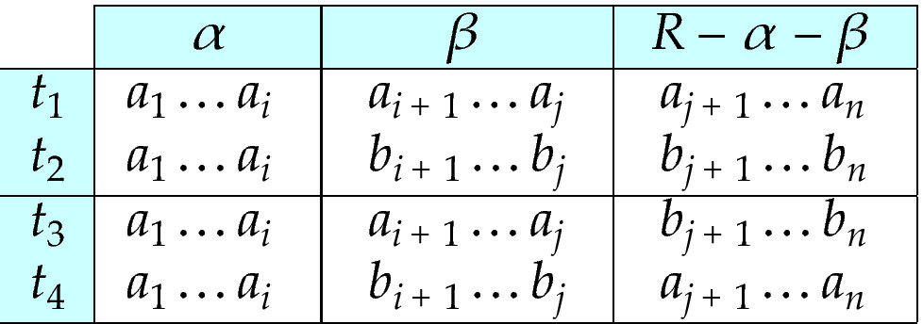
MVD -- Tabular representation
Tabular representation of α →→ β
Let R be a relation schema and let R₁ and R₂ form a decomposition of R . That is R = R₁ U R₂
We say that the decomposition if there is no loss of information by replacing R with the two relation schemas R₁ U R₂
Formally,
∏ _{R1} (r) ∏ _{R2} (r) = r
And, conversely a decomposition is lossy if
r ⊂ ∏ _{R1} (r) ∏ _{R2} (r) = r

Slide 5
MVD (Cont.)
Let R be a relation schema with a set of attributes that are partitioned into 3
nonempty subsets.
Y, Z, W
We say that Y →→ Z (Y multidetermines Z )
if and only if for all possible relations r (R )
< y₁, z₁, w₁ > ∈ r and < y₁, z₂, w₂ > ∈ r
then
< y₁, z₁, w₂ > ∈ r and < y₁, z₂, w₁ > ∈ r
Note that since the behavior of Z and W are identical it follows that
Y →→ Z if Y →→ W
Let R be a relation schema and let R₁ and R₂ form a decomposition of R . That is R = R₁ U R₂
We say that the decomposition if there is no loss of information by replacing R with the two relation schemas R₁ U R₂
Formally,
∏ _{R1} (r) ∏ _{R2} (r) = r
And, conversely a decomposition is lossy if
r ⊂ ∏ _{R1} (r) ∏ _{R2} (r) = r

Slide 6
Example
Let R be a relation schema and let R₁ and R₂ form a decomposition of R . That is R = R₁ U R₂
We say that the decomposition if there is no loss of information by replacing R with the two relation schemas R₁ U R₂
Formally,
∏ _{R1} (r) ∏ _{R2} (r) = r
And, conversely a decomposition is lossy if
r ⊂ ∏ _{R1} (r) ∏ _{R2} (r) = r
In our example:
ID →→ child_name ID →→ phone_number
The above formal definition is supposed to formalize the notion that given a
particular value of Y (ID) it has associated with it a set of values of Z
(child_name) and a set of values of W (phone_number), and these two sets are in
some sense independent of each other.
Note:
If Y → Z then Y →→ Z
Indeed we have (in above notation) Z₁ = Z₂
The claim follows.

Slide 7
Use of Multivalued Dependencies
Let R be a relation schema and let R₁ and R₂ form a decomposition of R . That is R = R₁ U R₂
We say that the decomposition if there is no loss of information by replacing R with the two relation schemas R₁ U R₂
Formally,
∏ _{R1} (r) ∏ _{R2} (r) = r
And, conversely a decomposition is lossy if
r ⊂ ∏ _{R1} (r) ∏ _{R2} (r) = r
We use multivalued dependencies in two ways:
1. To test relations to determine whether they are legal under a given set of
functional and multivalued dependencies
2. To specify constraints on the set of legal relations. We shall concern
ourselves only with relations that satisfy a given set of functional and
multivalued dependencies.
If a relation r fails to satisfy a given multivalued dependency, we can construct a
relations r′ that does satisfy the multivalued dependency by adding tuples to r.

Slide 8
Theorey of MVDs
Let R be a relation schema and let R₁ and R₂ form a decomposition of R . That is R = R₁ U R₂
We say that the decomposition if there is no loss of information by replacing R with the two relation schemas R₁ U R₂
Formally,
∏ _{R1} (r) ∏ _{R2} (r) = r
And, conversely a decomposition is lossy if
r ⊂ ∏ _{R1} (r) ∏ _{R2} (r) = r
From the definition of multivalued dependency, we can derive the following
rule:
If α → β, then α →→ β
That is, every functional dependency is also a multivalued dependency
The closure D⁺ of D is the set of all functional and multivalued dependencies
logically implied by D.
We can compute D⁺ from D, using the formal definitions of functional
dependencies and multivalued dependencies.
We can manage with such reasoning for very simple multivalued
dependencies, which seem to be most common in practice
For complex dependencies, it is better to reason about sets of dependencies
using a system of inference rules (Appendix C).

Slide 9
Fourth Normal Form
A relation schema R is in 4NF with respect to a set D of functional and multivalued dependencies if for all multivalued dependencies in D⁺ of the form α →→ β, where α ⊆ R and β ⊆ R, at least one of the following hold:
α →→ β is trivial (i.e., β ⊆ α or α ∪ β = R)
α is a superkey for schema R
If a relation is in 4NF it is in BCNF
Let R be a relation schema and let R₁ and R₂ form a decomposition of R . That is R = R₁ U R₂
We say that the decomposition if there is no loss of information by replacing R with the two relation schemas R₁ U R₂
Formally,
∏ _{R1} (r) ∏ _{R2} (r) = r
And, conversely a decomposition is lossy if
r ⊂ ∏ _{R1} (r) ∏ _{R2} (r) = r

Slide 10
Restriction of Multivalued Dependencies
The restriction of D to R_{i} is the set D_{i} consisting of
All functional dependencies in D⁺ that include only attributes of R_{i}
All multivalued dependencies of the form
α →→ (β ∩ R_{i})
where α ⊆ R_{i} and α →→ β is in D⁺
Let R be a relation schema and let R₁ and R₂ form a decomposition of R . That is R = R₁ U R₂
We say that the decomposition if there is no loss of information by replacing R with the two relation schemas R₁ U R₂
Formally,
∏ _{R1} (r) ∏ _{R2} (r) = r
And, conversely a decomposition is lossy if
r ⊂ ∏ _{R1} (r) ∏ _{R2} (r) = r

Slide 11
4NF Decomposition Algorithm
result: = {R}; done := false; compute D⁺; Let D_{i} denote the restriction of D⁺ to R_{i}
while (not done) if (there is a schema R_{i} in result that is not in 4NF) then begin
let α →→ β be a nontrivial multivalued dependency that holds on R_{i} such that α → R_{i} is not in D_{i}, and α∩β=φ; result := (result - R_{i}) ∪ (R_{i} - β) ∪ (α, β); end else done:= true;
Note: each R_{i} is in 4NF, and decomposition is lossless-join
Let R be a relation schema and let R₁ and R₂ form a decomposition of R . That is R = R₁ U R₂
We say that the decomposition if there is no loss of information by replacing R with the two relation schemas R₁ U R₂
Formally,
∏ _{R1} (r) ∏ _{R2} (r) = r
And, conversely a decomposition is lossy if
r ⊂ ∏ _{R1} (r) ∏ _{R2} (r) = r

Slide 12
Example
R =(A, B, C, G, H, I)
F ={ A →→ B
B →→ HI
CG →→ H }
R is not in 4NF since A →→ B and A is not a superkey for R
Decomposition
a) R₁ = (A, B) (R₁ is in 4NF)
b) R₂ = (A, C, G, H, I) (R₂ is not in 4NF, decompose into R₃ and R₄)
c) R₃ = (C, G, H) (R₃ is in 4NF)
d) R₄ = (A, C, G, I) (R₄ is not in 4NF, decompose into R₅ and R₆)
A →→ B and B →→ HI ➔ A →→ HI, (MVD transitivity), and
and hence A →→ I (MVD restriction to R₄)
e) R₅ = (A, I) (R₅ is in 4NF)
f)R₆ = (A, C, G) (R₆ is in 4NF)
Let R be a relation schema and let R₁ and R₂ form a decomposition of R . That is R = R₁ U R₂
We say that the decomposition if there is no loss of information by replacing R with the two relation schemas R₁ U R₂
Formally,
∏ _{R1} (r) ∏ _{R2} (r) = r
And, conversely a decomposition is lossy if
r ⊂ ∏ _{R1} (r) ∏ _{R2} (r) = r

Slide 13
Next Lecture
More Normal Form
Atomic Domains and First Normal Form
Database-Design Process
Modeling Temporal Data

